Slide 1
Perceptron
Dr. Jonathan V. Taylar

Slide 2
Objectives
Describe perceptron as the simplest neuron
Explain the activation function of perceptron

Slide 3
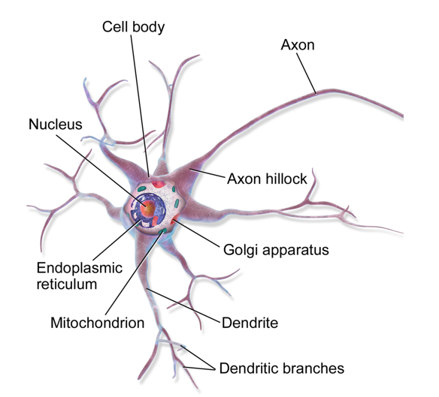
Perceptron
1958 - Frank Rosenblatt introduced perceptron
a form of neural network that may eventually be able to learn, make decisions, and translate languages
1969 - Marvin Minsky and Seymour Papert published a book ‘Perceptrons’
there were severe limitations to what perceptrons could do

Slide 4
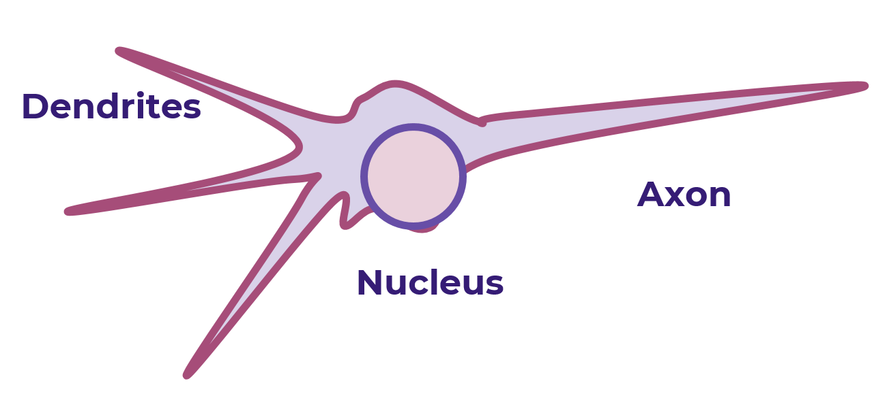
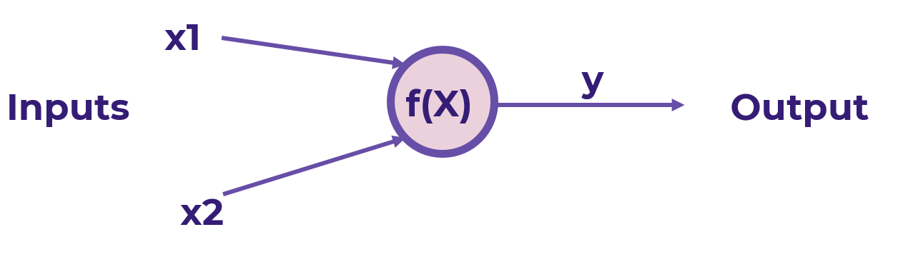
Perceptron
Amazing power of neural networks stem from the simple perceptron model
A perceptron consists of one or more inputs, a processor and a single output
follows the “feed-forward” model, meaning inputs are sent into the neuron, are processed, and result in an output

Slide 5
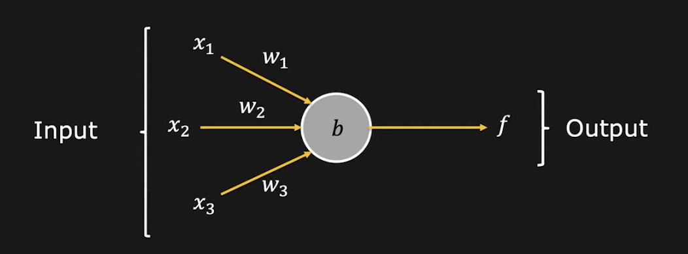
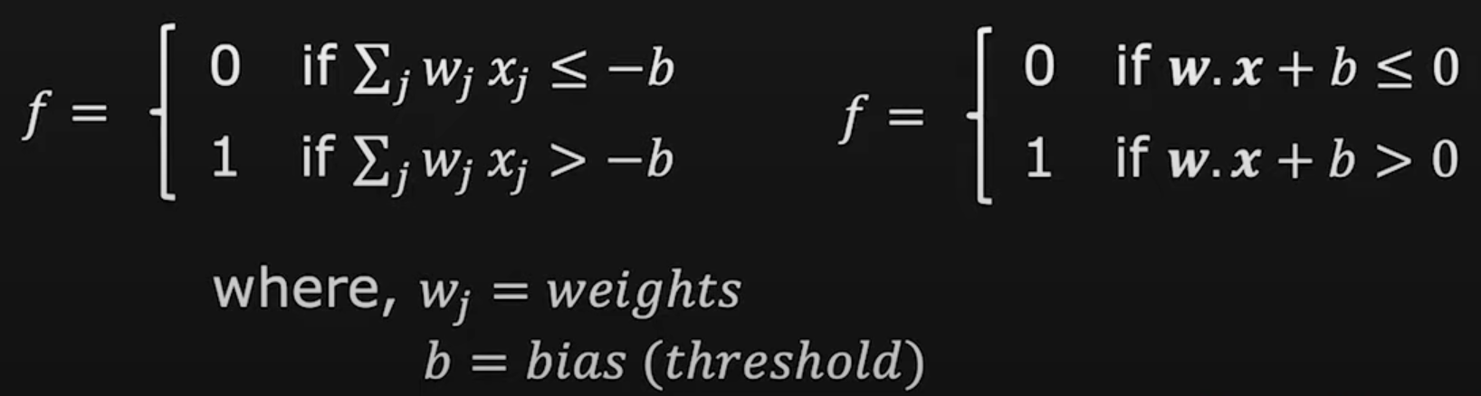
Perceptron
Takes in inputs (x1 to x3)
Produces a binary output or a decision f
Takes the inputs and it multiplies the inputs with its weights (w1 to w3)
Compares the weighted sum of the inputs with a threshold or bias (b)
Based on the comparison, puts an output, either a 0 or 1

Slide 6
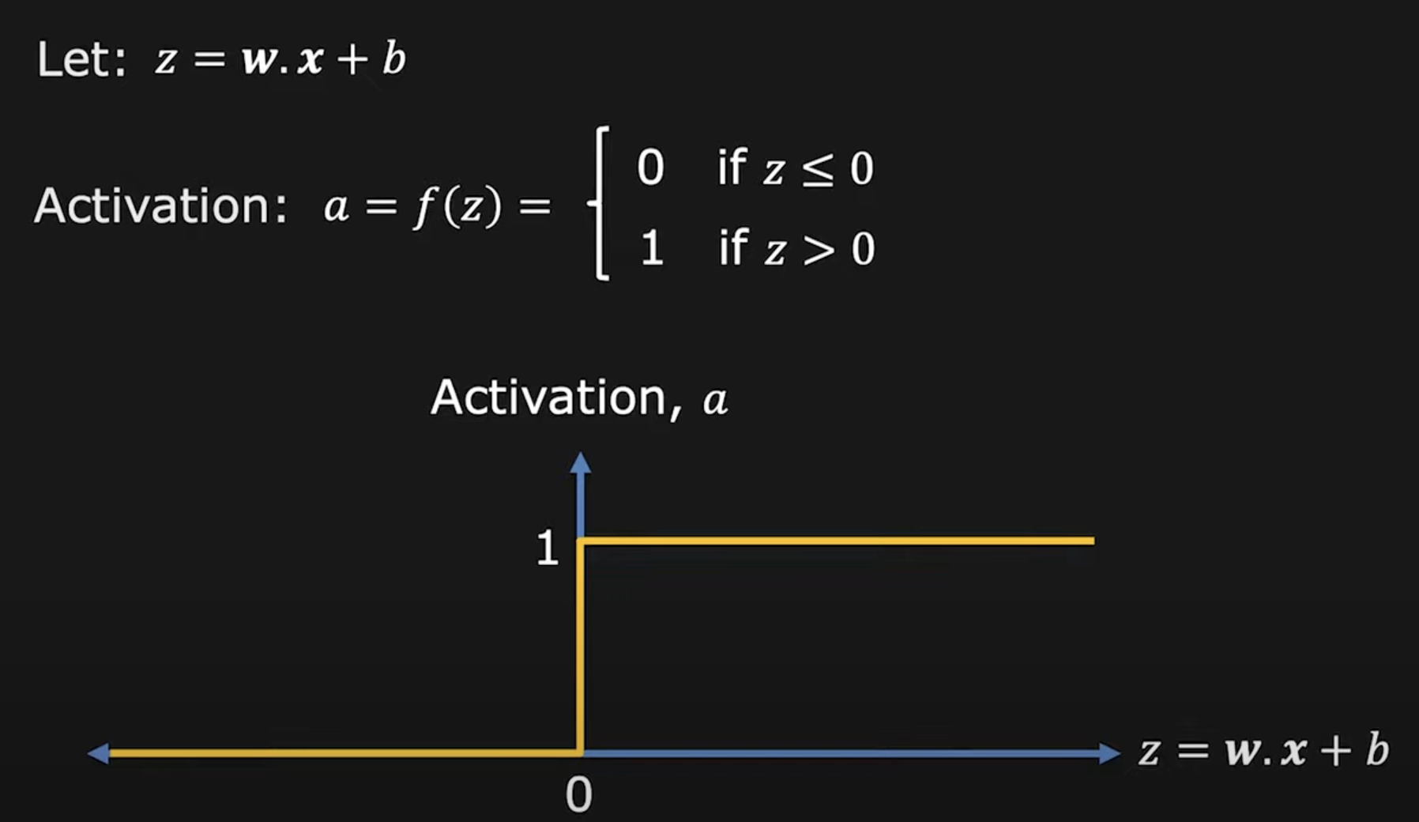
Activation Function
You get a value for z if you apply a function to it
The function f is a step function or the heavy side function
The activation function of a perceptron is the step function.

Slide 7
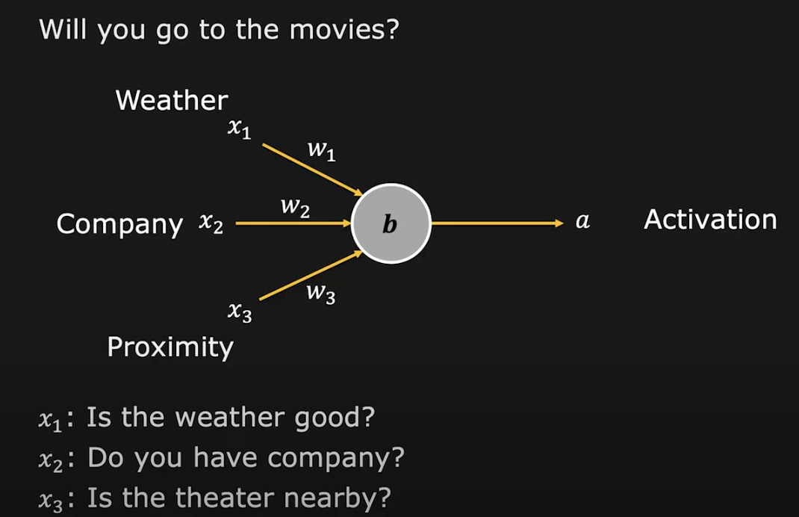
Perceptron Example
Assume the weather is the most important factor: w1 = 4, w2 = 2, w3 = 2
Assign a bias of -5

Slide 8
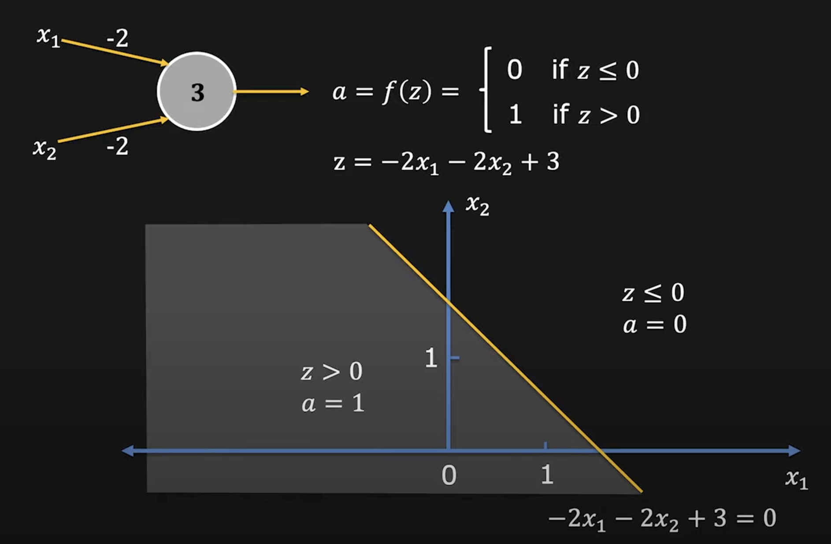
Perceptron as a Linear Classifier

Slide 9
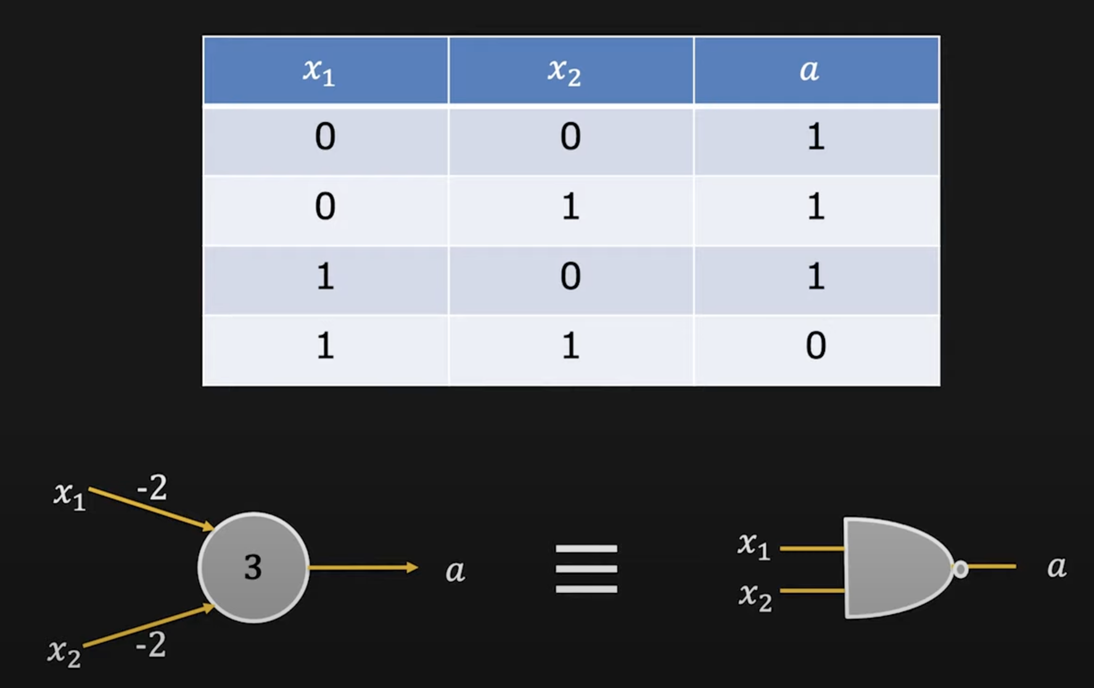
Perceptron as a NAND Gate
Perceptron is like a universal NAND gate, which means that all other gates (OR, AND and NOT) can be constructed using one of more NAND gates
Since NAND gate can be implemented using a perceptron, perceptrons are universal for computation

